Slide 1
COVID-19 Detection using chest radiography
Team Members:
1. Shweta Gaikwad
2. Pallavi Karde
3. Vaibhav Maindad
4. Kaustubh Pawar
Guided by:
Prof. Sumit Harale

Slide 2
Agenda
1.Aim
2. Proposed System
3. Implementation Execution
5. Performance Evaluation
7.Comparison with existing system
8.Publication status
9.Conclusion
10.References

Slide 3
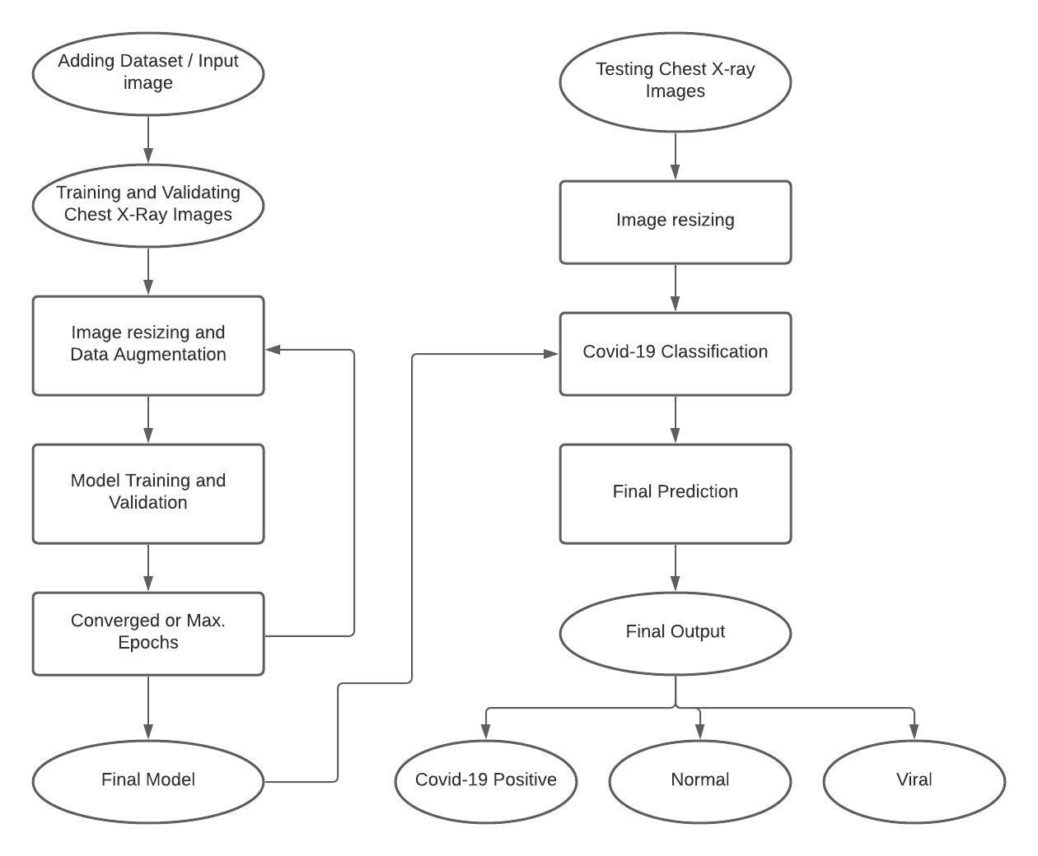
Proposed System

Slide 4
Implementation Execution(Bold, Font Size:44)
Execute your project

Slide 5
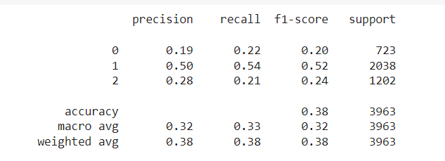
Performance Evaluation
VGG 16

Slide 6
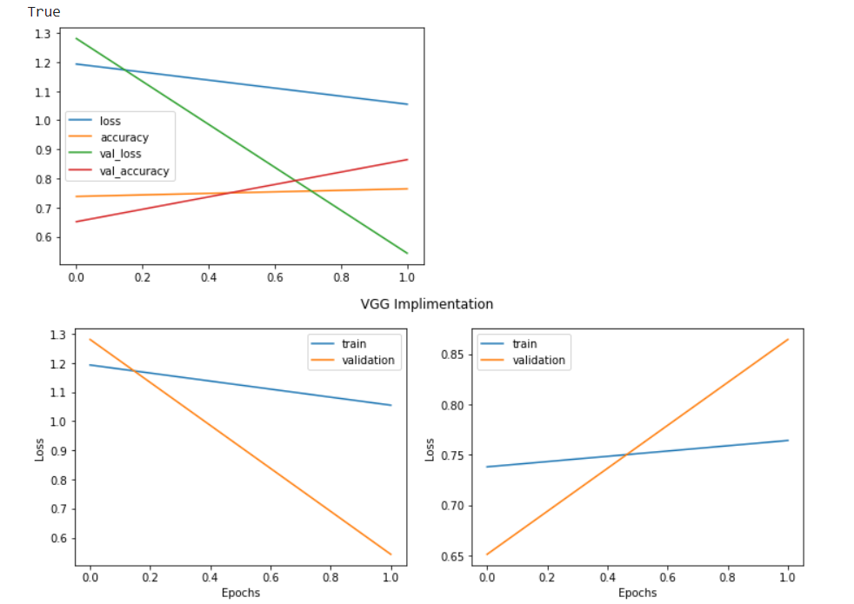

Slide 7
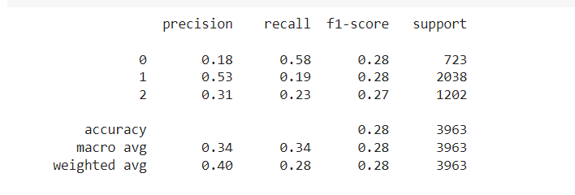
Resnet

Slide 8
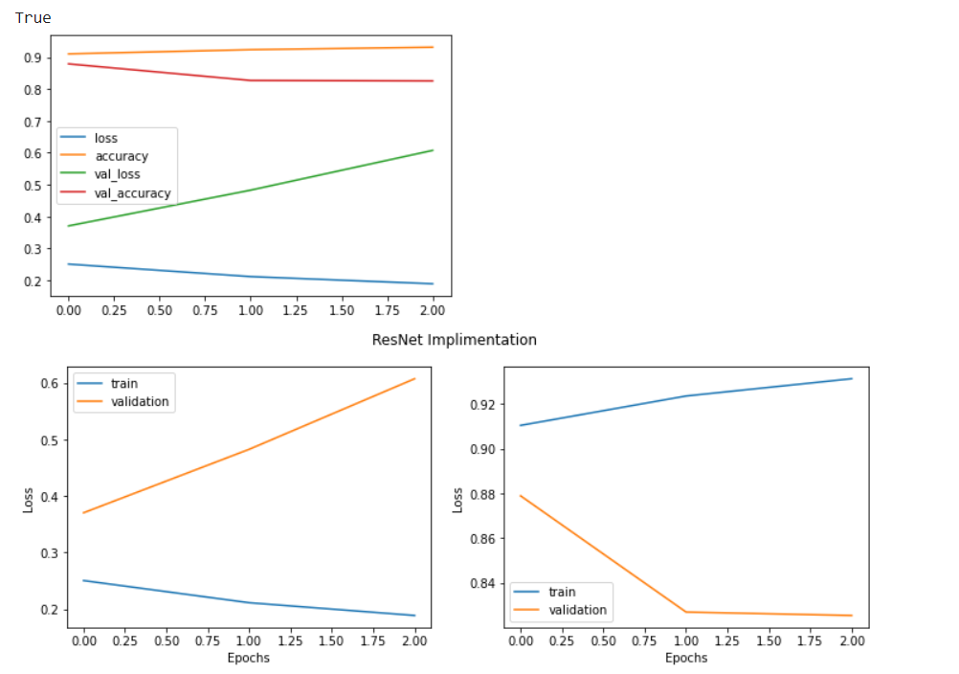

Slide 9
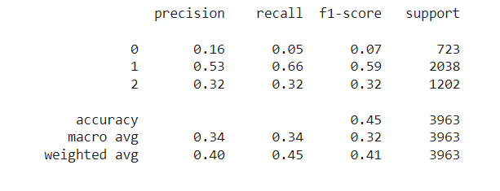
CNN

Slide 10
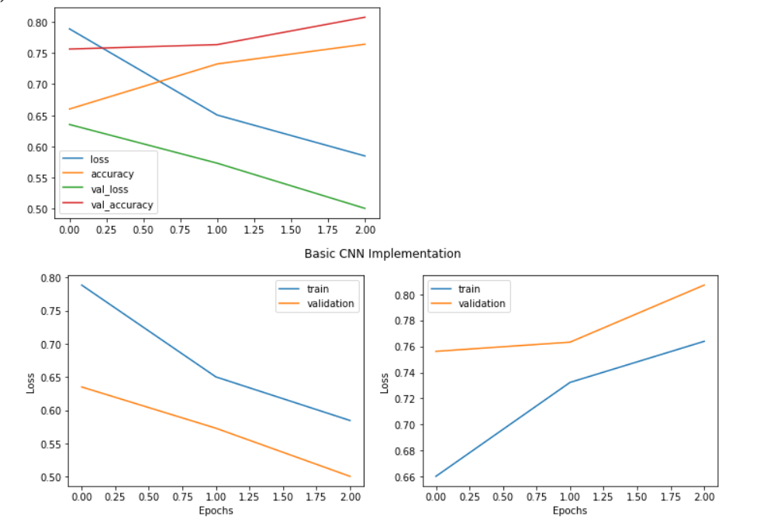

Slide 11
Comparison with existing
Existing System
Our System
Existing system has accuracy about 80 to 90% for 2 class classification.
Existing system used vgg 16and CNN algorithm
They had used open-source dataset i.e., Kaggle chest x ray competition dataset
They used 25 epochs
Our system has accuracy about 80 to 90% for 3 class classification.
We have used vgg 16, Resnet and CNN to increase accuracy
We also used open-source dataset i.e., Kaggle chest x ray competition dataset
We have used 15 epochs

Slide 12
Publication Status

Slide 13
Conclusion
We used the deep learning model to detect COVID19 using chest radiographs automatically.
• The study shows the robust and effective method of non-contact testing on COVID patients, which can help in early and cost-effective detection and screening of COVID cases.
• Grad CAM images of chest radiographs are presented, which shows the regions of interest for confirmed COVID-19 positive cases, bacterial pneumonia, and healthy cases.
• We believe that this study could be used as an initial screening, which can help healthcare professionals to treat the COVID patients by timely detecting better and screening the presence of disease.
• It provides not only a cost-effective but also an automatic noncontact testing method, which helps in reducing the risk of COVID contraction by medical practitioners

Slide 14
References
[1] M.K. Pandit, S.A. Banday, R. Naaz, M.A. Chishti, Automatic detection of COVID-19 from chest radiographs using deep learning, Radiography, Volume 27, Issue 2, 2021, Pages 483-489, ISSN 1078-8174, https://doi.org/10.1016/j.radi.2020.10.018.
[2] Journal Article Kusakunniran, Worapan Karnjanapreechakorn, Sarattha Siriapisith, Thanongchai Borwarnginn, Punyanuch Sutassananon, Krittanat Tongdee, Trongtum Saiviroonporn, Pairash COVID-19 detection and heatmap generation in chest x-ray images 8 Journal of Medical Imaging S1 014001 2021 https://doi.org/10.1117/1.JMI.8.S1.014001 DOI 10.1117/1.JMI.8.S1.014001 SPIE
[3] SOM-LWL method for identification of COVID-19 on chest X-rays Osman AH, Aljahdali HM, Altarrazi SM, Ahmed A (2021) SOM-LWL method for identification of COVID-19 on chest X-rays. PLOS ONE 16(2): e0247176. https://doi.org/10.1371/journal.pone.0247176
[4] COVID-19 pneumonia on chest X-rays: Performance of a deep learning-based computer-aided detection system Hwang EJ, Kim KB, Kim JY, Lim JK, Nam JG, et al. (2021) COVID-19 pneumonia on chest X-rays: Performance of a deep learning-based computer-aided detection system. PLOS ONE 16(6): e0252440. https://doi.org/10.1371/journal.pone.0252440

